Slide 1
chapter 10
The Internet

Slide 2
CHAPTER OBJECTIVES
10-<number>
Identify and describe important historically significant events in the development of the Internet.
Discuss the topology of the Internet.
Define the Domain Name System and describe the purpose of Name Servers.
List and describe common Internet protocols and applications.
Discuss Internet2, the Abilene Project, and Internet2 working groups.
Describe IPv6 business drivers and addressing Schemes.

Slide 3
AN INTRODUCTION TO THE INTERNET
10-<number>
The Internet was “born” on September 1, 1969 under the auspices of the Advanced Research Projects Agency (ARPA).
In its original form, it was known as the ARPANET, short for ARPA network.
A computer at UCLA was the first computer connected to the ARPANET.
4 computers were online by the end of 1969.
13 computers were connected to the ARPANET by the end of 1970.
More than 16 sites in 1971 and 30+ sites in 1972.
40+ sites in 1973, and ARPANET had international presence that year.

Slide 4
AN INTRODUCTION TO THE INTERNET (cont’d)
10-<number>
Vinton Cerf and Robert Kahn developed TCP in 1973.
Supervision of ARPANET was transferred to the Defense Communications Agency (DCA) in 1975.
TCP was re-engineered in 1978 into two parts: TCP and IP.
TCP and IP became the standard ARPANET transmission protocols in 1981 with complete migration by year end 1982.
DCA split the ARPANET into two networks in 1983 – MILNET and ARPANET, both under military supervision.

Slide 5
AN INTRODUCTION TO THE INTERNET (cont’d)
10-<number>
The ARPANET experienced significant growth after its split from MILNET.
The National Science Foundation (NSF) began funding connectivity between CSNET and ARPANET in the early 1980s.
In 1984, the NSF built 5 regional supercomputing centers.
In 1985, NSF linked them together to form the NSFNET.
The original links for NSFNET were 56 Kbps leased lines.
By 1987 the connectivity was being upgraded to T1 lines.

Slide 6
AN INTRODUCTION TO THE INTERNET (cont’d)
10-<number>
Military jurisdiction of the Internet ended in 1990.
As late as the early 1990s, NSFNET was still limited to research and academic activities.
Private, for profit commercial TCP/IP data networks sprang to life from carriers such as AT&T, MCI, and Sprint.
Once these commercial data network backbones were in place, the NSF developed a plan to privatize the Internet.
Privatization took effect in 1994, and the NSF backbone was decommissioned in April 1995, making the Internet a private commercial enterprise maintained by ISPs.

Slide 7
AN INTRODUCTION TO THE INTERNET (cont’d)
10-<number>
Internet topology is comprised of:
  national ISPs (also known as national services providers, or NSPs)
  regional ISPs
  local ISPs
  network access points (NAPs)
  metropolitan area exchanges (MAEs)
  Internet exchange points (EPs or IXs or IXPs)
  ISP points of presence (PoPs)
  local exchange carriers (LECs)
  computers and networks that are located in homes and businesses all over the world.

Slide 8
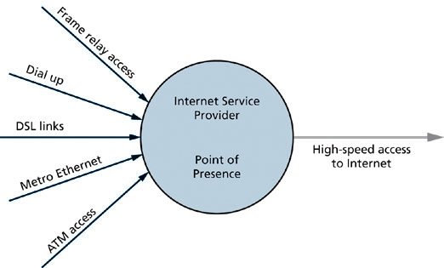
Connectivity to an ISP
10-<number>

Slide 9
ACCESSING INFORMATION ON THE INTERNET
10-<number>
Mainframe and server computers can be configured to deliver content such as files, Web pages, or streaming media.
Protocols such as IP, DNS, HTTP, and FTP assist in locating data on the Internet.
Internet domains such as .com, .net, .org, and .int loosely organize data access by function or geography.
DNS assists data access by resolving friendly names to IP addresses.
Applications such as email, instant messaging, and VoIP provide person-to-person, person-to-group, and group-to-group communication capability.

Slide 10
ACCESSING INFORMATION ON THE INTERNET (cont’d)
10-<number>
The Origin of the Domain Name System
  The original ARPANET computers required hosts.txt files to locate other computers on the ARPANET.
  Each time a site added a computer, a new entry had to be added to a main hosts.txt, located at the Stanford Research Institute on its Network Information Center (NIC) computer, and then the new hosts.txt had to be downloaded to each site and installed on each computer at each site.
  Updating and downloading hosts.txt increased ARPANET traffic, the potential for two or more sites generating the same name for a new computer was a real possibility, and maintaining a consistent hosts.txt file across an expanding ARPANET was becoming more difficult as the ARPANET grew.

Slide 11
ACCESSING INFORMATION ON THE INTERNET (cont’d)
10-<number>
The Origin of the Domain Name System (cont’d)
  The problems related to maintaining hosts.txt presented a serious disruptive threat to the ARPANET in the early 1980s.
  In 1983, Paul Mockapetris and Jon Postel formulated a distributed database of host names and addresses that could replace hosts.txt.
  This replacement became known as domain name system (DNS) technology and was originally specified in Request for Comment (RFC) 882.
  Newer RFCs that have added functionality to DNS supplant the original DNS RFC.

Slide 12
ACCESSING INFORMATION ON THE INTERNET (cont’d)
10-<number>
The Origin of the Domain Name System (cont’d)
  With the introduction of DNS, control of host names and addresses shifted from centralized control to distributed control.
  DNS distributes host information automatically to DNS servers throughout the network.
  Internet hosts use the distributed database to resolve host names to IP addresses.

Slide 13
ACCESSING INFORMATION ON THE INTERNET (cont’d)
10-<number>
Name Servers
  Are known as DNS servers on the Internet.
  Are generally located in pairs at every local, regional, and national ISP.
  Supply client computers with the IP address of the requested Web site.
  Are configured with operating system software and DNS software.
  Store a portion of the DNS database.
  Are configured to communicate with at least one other DNS server.
  Have the ability to cache Web site address information received during a query of another DNS server.

Slide 14
ACCESSING INFORMATION ON THE INTERNET (cont’d)
10-<number>
Internet Domains
  Provide organization and hierarchical structure to the Internet.
  Top-level domains (TLDs) include: .com, .net, .org, .gov, .biz, and others.
  Millions more domains exist under TLDs.
  The domain space that we use when we access the Internet starts at the root domain, which is represented as a “.”
  TLDs exist under the root domain.
  The maximum length of a domain name is 255 characters, dots excluded, and the portion of the domain name between the dots is restricted to 63 characters.

Slide 15
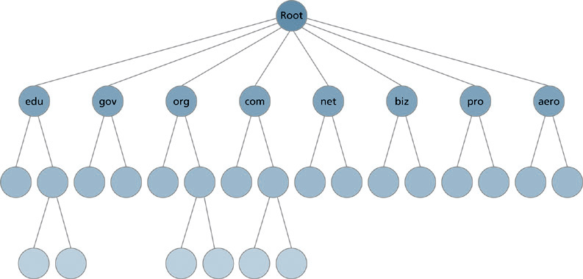
DNS Name Space
10-<number>

Slide 16
ACCESSING INFORMATION ON THE INTERNET (cont’d)
10-<number>
Internet Domains (cont’d)
  The original 7 TLDs, known as generic TLDs (gTLDs) were:
    .com, .edu, .gov, .int, .mil, .net, .org, and .arpa
  Some of the new TLDs include country code TLDS (ccTLDs) as well as various organization types, including:
    .aero, .biz, .info, .museum, .name, .pro, and others.

Slide 17
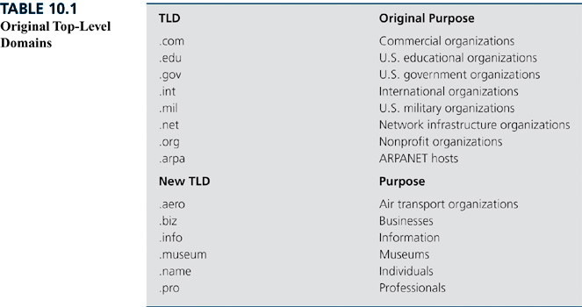
Original Top-Level Domains
10-<number>

Slide 18
ACCESSING INFORMATION ON THE INTERNET (cont’d)
10-<number>
Internet Protocols
  TCP and IP were the originals developed in the 1970s to provide efficient data transmission across the ARPANET.
  Today, there’s an entire suite of Internet protocols.
    Address resolution protocol (ARP) is used to map each MAC address to an IP address.
    DHCP automatically assigns IP address information to client computers.
    DNS provides name resolution.
    iSCSI provides data transport in SANs
    LDAP provides directory support and access to databases.
    HTTP supports access to Web pages.

Slide 19
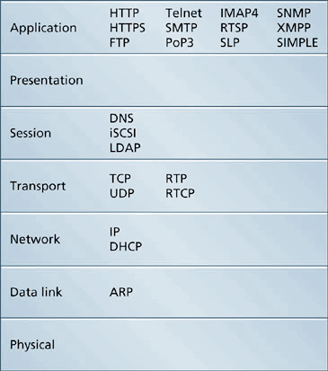
TCP/IP Protocols within the OSI Model Layers
10-<number>

Slide 20
ACCESSING INFORMATION ON THE INTERNET (cont’d)
10-<number>
Internet Applications
  File Transfer – FTP and HTTP are OSI application layer protocols that allow Internet users to transfer files between locations.
  Remote Computing – Telnet is an OSI application layer protocol that allows users to log in to remote computers and networking devices. Secure Shell (SSH) is much like Telnet, except SSH encrypts the data transfer between devices.
  Streaming Media – utilizes underlying transport and control protocols such as RTP, UDP, and RTCP, but the OSI application layer protocol that assists with streaming media is RTSP.

Slide 21
ACCESSING INFORMATION ON THE INTERNET (cont’d)
10-<number>
Internet Applications (cont’d)
  Email – SMTP, POP3, and IMAP4 are the three primary OSI application layer Internet protocols that support email.
  Instant Messaging – Extensible Messaging and Presence Protocol (XMPP) and the Session Initiation Protocol for Instant Messaging and Presence Leveraging Extensions (SIMPLE) are the standardized protocols that support instant messaging and the convergence of multiple data communications technologies such as email, voice mail, group scheduling, videoconferencing, whiteboarding, calendaring, and voice and video chat through instant messaging.

Slide 22
THE FUTURE OF THE INTERNET
10-<number>
vBNS
  MCI runs the very-high-speed Backbone Network Service (vBNS), a high-speed network that came online in 1995 to connect the NSF’s supercomputing centers.
  Development work continues on the vBNS with upgrades to existing bandwidth (currently 2.4 Gbps), but vBNS is no longer funded by the NSF.

Slide 23
THE FUTURE OF THE INTERNET (cont’d)
10-<number>
Internet2
  Started in 1996 by 34 universities to create the next generation of Internet applications and technologies.
  Today it’s a consortium of more than 200 universities collaborating with government and the private sector to build, test, and deploy advanced applications and technologies.
  Internet2 is not a network infrastructure.

Slide 24
THE FUTURE OF THE INTERNET (cont’d)
10-<number>
Internet2 (cont’d)
  The Abilene Project is the actual physical communications network that supports Internet2 activities.
  Abilene provides universities and research institutions with the bandwidth to test and implement the advanced technologies and applications of Internet2.
  Abilene went live in 1999 with SONET OC-48 circuits that provided 2.4 Gbps of bandwidth.
  In early 2004, Abilene was upgraded to OC-192 circuits that provide 10 Gbps of bandwidth.
  Abilene is not currently interconnected with the commercial ISP networks that comprise the Internet.

Slide 25
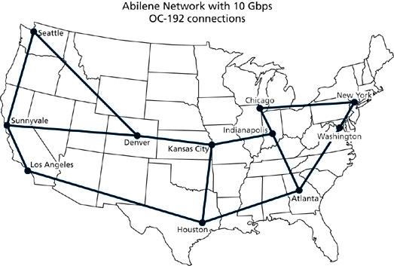
The Abilene Network
10-<number>

Slide 26
THE FUTURE OF THE INTERNET (cont’d)
10-<number>
Internet2 (cont’d)
  Numerous working groups (WGs) support advanced service, application, and technology development.
  WGs include:
    Campus Bandwidth Management, Digital Video, Integrated Infrastructure for Instant Messaging, IPv6, MACE-Shibboleth, MACE-WebISO, Multicast, Orthopaedic Surgery, Presence and Integrated Communications, VidMid Video Conferencing, VidMid Video on Demand, Voice over IP, and others.

Slide 27
THE FUTURE OF THE INTERNET (cont’d)
10-<number>
The Next Generation Internet Protocol
  Provides the foundation for the Internet applications and services being developed under Internet2.
  IPv4 is the current generation of IP addressing and uses 32 bits to define each host.
  IPv6 is the next generation of IP addressing, and it uses 128 bits to provide over 340 trillion trillion trillion addresses.
  IPv6 is currently implemented a numerous sites that utilize vBNS and Abilene.
  IPv6 is monitored by the IPv6 working group of Internet2.

Slide 28
THE FUTURE OF THE INTERNET (cont’d)
10-<number>
IPv6 Business Drivers
  The need to provide IP addresses to a growing number of devices.
  Next-generation business applications.
  The growing use of mobile and wireless devices.
  Increased exposure of data as it is transmitted across the Internet.

Slide 29
THE FUTURE OF THE INTERNET (cont’d)
10-<number>
IPv6 Addressing
  IPv6 addresses use 128 bits that are divided into eight 16-bit sections.
  There are no address classes such as the Class A, Class B, and Class C addresses that were defined in IPv4.
  IPv6 addresses are comprised of global routing prefix bits that identify routing information, subnet bits to identify a link within a site, and interface ID bits to identify a specific node.

Slide 30
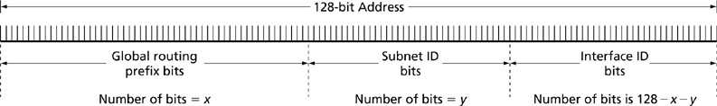
IPv6 Generic Address Format
10-<number>

Slide 31
THE FUTURE OF THE INTERNET (cont’d)
10-<number>
IPv6 Addressing (cont’d)
  IPv6 addressing includes some abbreviations.
  The address:
    FE80:0000:0000:0000:ABCD:FF32:030C:1234
    can be abbreviated as
    FE80:0:0:0:ABCD:FF32:30C:1234
    or even
    FE80::ABCD:FF32:30C:1234

Slide 32
THE FUTURE OF THE INTERNET (cont’d)
10-<number>
IPv6 Address Types
  Unicast – identify the individual unique interfaces on an IPv6 network.
    Global unicast – an IPv6 address that is unique across the entire IPv6 address space.
    Anycast – an IPv6 address that’s assigned to more than one interface.
    Link-local unicast – an IPv6 address that is used in small or temporary networks in which all computers are on the same subnet. This type of address is not designed to be routed.

Slide 33
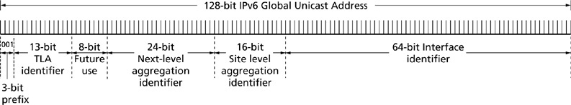
Global Unicast Address Bit Order
10-<number>

Slide 34
THE FUTURE OF THE INTERNET (cont’d)
10-<number>
IPv6 Address Types (cont’d)
  Unicast (cont’d)
    Unique local unicast – an IPv6 address that specifies internal routing of IPv6 packets.
    IPv4-compatible – an IPv6 address that dynamically tunnels IPv6 packets over an IPv4 infrastructure.
    IPv4-mapped – an IPv6 address that represents IPv4 node addresses as IPv6 addresses for transmission across an IPv6 routing infrastructure.

Slide 35
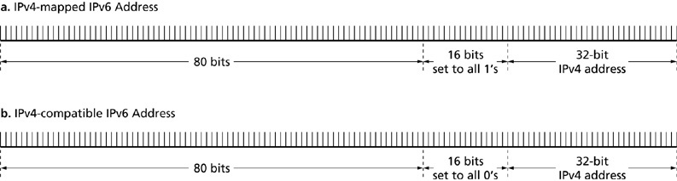
Embedded IPv6 Addresses
10-<number>

Slide 36
THE FUTURE OF THE INTERNET (cont’d)
10-<number>
IPv6 Address Types (cont’d)
  Multicast – multicast addresses are specified for routing packets to groups of IPv6 interfaces.
  Unspecified – the unspecified address is used only as a source address during bootup when a device is negotiating for its address information.
  Loopback – is used in troubleshooting the IPv6 configuration of an interface.

Slide 37
THE FUTURE OF THE INTERNET (cont’d)
10-<number>
Impact on the Organization
  Improved transmission performance for time-critical applications.
  QoS will be substantially improved.
  Internet2 applications promise to deliver real-time classroom instruction from anywhere and at anytime to anywhere and at anytime.
  IPv6 will support next generation services and applications.

Slide 38
THE FUTURE OF THE INTERNET (cont’d)
10-<number>
Impact on the Organization (cont’d)
  Application developers will be able to focus on the important features of applications rather than waste time developing authentication and Web logon specifications.
  Instant messaging promises an Internet of converged services – a world in which all kinds of data such as audio, video, voice, and text can be simultaneously and interactively shared.

